Slide 1
Lab 3 (Multi-Threading in Java)
CSE 2200 : Advanced Programming
Google Classroom : https://classroom.google.com/c/Njk2Nzk1NTgwMDA3?cjc=sx63jog
Argha Chandra Dhar
Lecturer,
Dept of CSE, KUET
Email: dhar@cse.kuet.ac.bd
Kazi Saeed Alam
Assistant Professor,
Dept of CSE, KUET
Email: saeed.alam@cse.kuet.ac.bd

Slide 2
Why Java is Important?
Trouble with C/C++ language is that they are not portable and are not platform independent languages.
Emergence of World Wide Web, which demanded portable programs.
Portability and security necessitated the invention of Java.

Slide 3
Thread
Thread: a flow of control in a program
Process: a running instance of a program including all variables and other states.
In Java,
Application: the Java interpreter starts a thread for the main method.
Applet: the Web browser starts a thread to run the applet.
Java has built-in support for multi-threading.

Slide 4
Thread(contd..)
Thread is a lightweight sub process.
Smallest independent unit of a program.
Contains a separate path of execution.
Every Java program contains at least one thread.
A thread is created and controlled by java.lang.Thread class

Slide 5
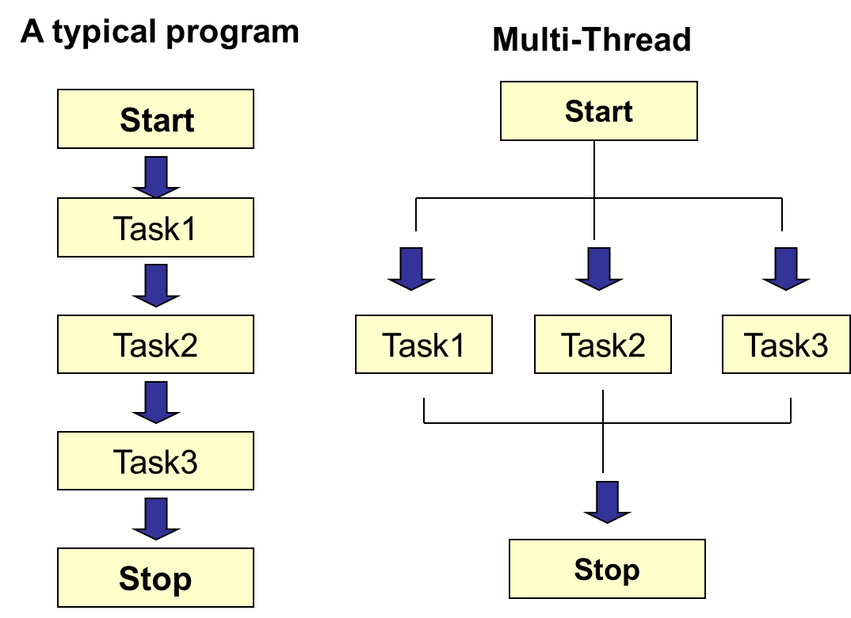
Thread(contd..)

Slide 6
Multi-Threading
Multi-threading is the capability of running multiple tasks concurrently within a program.
Multi-threading can make your program more responsive and interactive, and run faster than a non-threaded version.
Issues
Prioritization
Synchronization

Slide 7
Creating Thread
Thread class
Extend Thread class and override the run method
Example
class SimpleThread extends Thread {
public void run() {
// work for thread
}
}
SimpleThread t = new SimpleThread () ; // create thread
t.start(); // begin running thread

Slide 8
Creating Thread
Runnable interface
Create object implementing Runnable interface
Pass it to Thread object via Thread constructor
Example
class SimpleThread extends Frame
implements Runnable {
public void run() {
// work for thread
}
}
Thread t = new Thread(new SimpleThread()); // create thread
t.start(); // begin running thread

Slide 9
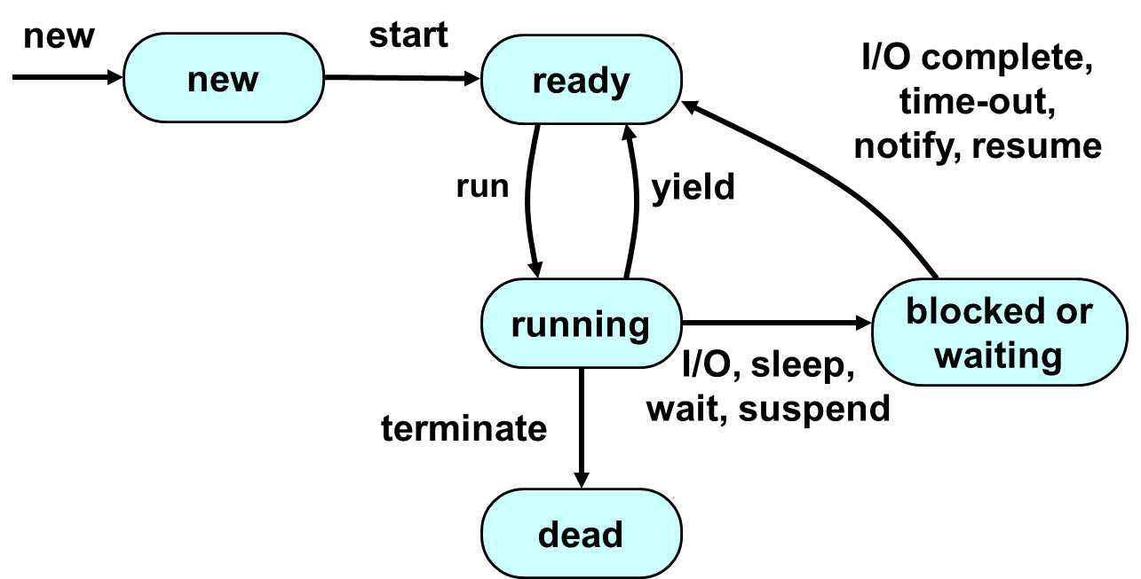
Life Cycle of a Thread

Slide 10
Life Cycle of a Thread

Slide 11
Overview of the Thread Methods
run():void perform an action for the thread.
start():void – to make a Thread eligible for use
sleep():void – to make a Thread inactive
interrupt():void – to interrupt a running Thread
join():void - waits for a thread to die.
isAlive():boolean – to check status of a Thread
Other methods
Stop(), setPriority(p: int), wait(), notify()…
For more see: https://www.javatpoint.com/creating-thread

Slide 12
Thread Synchronization
To avoid resource conflicts, may synchronize method invocation so that only one thread can access a method at a time.
Keyword synchronized
Only one thread at a time to execute statements within synchronized blocks.
All other threads block until the method finishes.
If several synchronized statements are trying to execute on an object at the same time, only one of them is active on the object.

Slide 13
Thank You!!!

